Slide 1
GROSS GRAMMATICAL
&
TECHNICAL ERRORS
Ist B.Tech – IIT(ISM) DHANBAD

Slide 2
Bad Habits to Avoid in Academic Writing
Second person “you”
(you will realize)
Inconsistent person
Inconsistent tense
Abbreviations use
(use standard version & all protocol)
Do not use: ya, thru, wanna, gonna
Do not use: etc., & use ‘other’ instead

Slide 3
OVERLY-LONG SENTENCES
A sentence should express only one idea or a clearly connected set of ideas.
Home care has been expanding tremendously over the past few years partly due to recent technological advances that enable assessments and treatments to be a part of the home setting which at one time could only be performed within the hospital environment. - X
Home care has expanded tremendously over the past few years. This increase is partly due to recent technological advances that now make more assessments and treatments possible in the home rather than only in the hospital. - OK
X
.

Slide 4
WORDINESS - use the minimum number of words.
Check your writing to make sure you don’t have unnecessary words or phrases.
You may often find that there are a number of Words contained in your writing that can be safely eliminated without any kind of danger to your meaning whatsoever. X
You may often find that there are a number of words contained in your writing that can be safely eliminated without any kind of danger to your meaning whatsoever.
(Beer & McMurrey 34)
Notes:
Better example – marg’s
Unitec New Zealand

Slide 5
MORE
Basically, industrial productivity generally relies on particular factors that are actually more psychological in kind than of any given technological type. - X
Industrial productivity depends more on psychological than on technological factors. -

Slide 6
Redundancy
Redundant words can make a sentense loose, powerless, and even ridiculous. For ex.,
Eyewitness present at the scene
The wet rain soaked us to the skin.
Each person must take care of his own individual work.
I am going to paint my own house this summer. (only emphasis)
Ultrasound is not audible to the ear.
Most of stars are invisible to the (bare) eye in a moonlight night.
We must cooperate together (cooperate jointly).

Slide 7
MORE
We have 10 different kinds of soup on the menu.
The end result was that there was little room for improvement in our work.
The end result of the experiment proved that we had failed. (= conclusion)
It is always enjoyable for a person to relax on a warm day.
The lake is too cold for people to go swimming (too cold for swimming).
We must repeat our experiment again.
He is going to repeat the lecture for a second time.
The garden is surrrounded entirely by the wall.

Slide 8
There/their/they’re
“There” is used in two ways
  Can specify a place
  Can be used as an expletive or empty word to start a sentence
“Their” is the possessive form of “they”
“They’re” is the contracted form of “they are”

Slide 9
Its/it’s
“Its” is the possessive form of the pronoun
  That is a good book. Its title is…..
“It’s” is the contracted form of “it is” or “it has”
  It’s time to go.
  It’s been great.

Slide 10
Your/you’re
“Your” is the possessive form of a personal pronoun
  I like your website.
“You’re” is the contracted form of “you are”
  You’re a dedicated student.

Slide 11
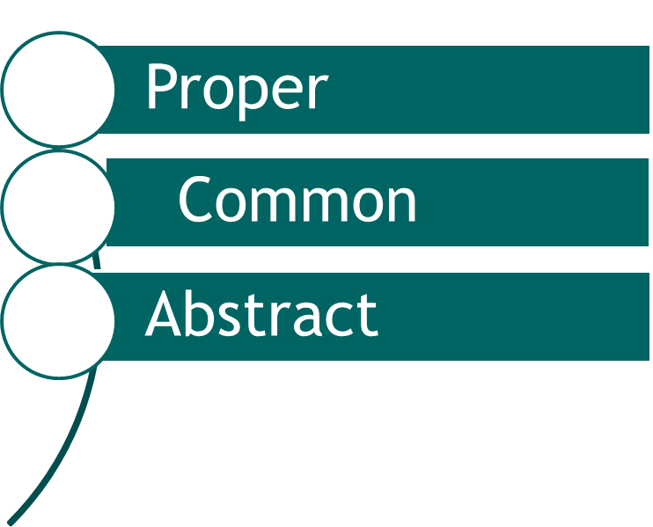
NOUN – TYPES
ERROR BASED ON NOUN
Countable
Uncountable
Material
Collective

Slide 12
UNCOUNTABLE NOUNS – AS SINGULAR
Luggage, advice, furniture, information, baggage, scenery, poetry, wood, iron, silk, The nouns such as – Jury, choir, committee, council, crowd, herd, orchestra, team, government, mob, community, union, club, opposition, firm, flock etc. are used as collective nouns to denote a group.
A piece of (Singular)
Pieces of (Plural)
A bit of (Singular)
Bits of (Plural)
A heap of (Singular)
Heaps of (Plural)
A loaf of (Singular)
Loaves of (Plural)

Slide 13
SOME NOUNS – TAKES SINGULAR VERB
mathematics > mathematics is tough
politics > politics is nasty
Ethics > ethic is necessary
fuel> fuel is costly
rice> Rice is ready

Slide 14
SINGULAR NOUNS – TAKES PLURAL VERB
People > people talk
Clergy > clergy pray
Cattle > cattle roam
Gentry > gentry sit
Company > company march
Police > police intervene

Slide 15

Always Plural
Nouns like the following are always plural (because they are made of two parts):
  scissors
  tweezers
  trousers
  pants
  shears

Slide 16
Always Singular
The following words are always singular and require a singular verb:
  each, each one
  either, neither
  everyone, anyone, someone, no one
  everybody, anybody, nobody

Slide 17
Confusion – countable / uncountable
Countable | Uncountable
Dollar | money
Song | music
Suitcase | luggage
View | Scenery
Journey | Travel
Report | information
Tip | advice

Slide 18
PRONOUN – ERROR
1st, 2nd & 3rd person in a single sentence – then causation – order should be 2nd+3rd+1st
use of it > For little child / Toddler :
* The newborn is crying for its mother
use of it > For Emphasis
* it is me who has done this.
if the gender is not mentioned, then The gender of indefinite pronoun (Everyone, anybody, someone, no one ), in isolation, is always to be masculine.

Slide 19
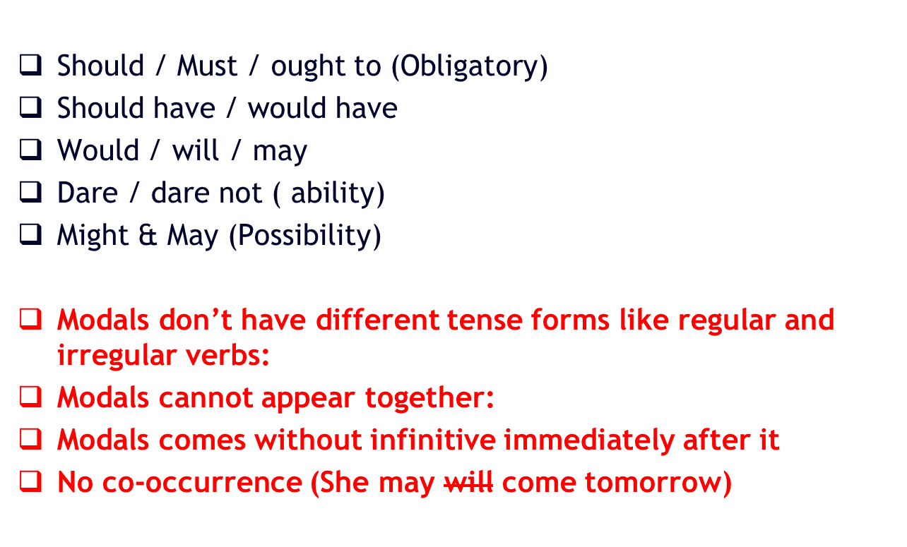
MODAL VERBS

Slide 20
COMMON RULES
S-V AGREEMENT ISSUE and error
With… | Use a…
I | singular verb (no “s”)
You | plural verb (no “s”)
He, She, It | singular verb (“s”)
We | plural verb (no “s”)
You | plural verb (no “s”)
They | plural verb (no “s”)

Slide 21
Special Agreement Rules
When the subject is made up of two or more nouns connected by and, use a plural verb.
She and her friends are…
implies two
plural verb

Slide 22
Special Agreement Rules
When the subject is made up of two or more singular nouns connected by or, use a singular verb.
  The book or the pen is…
implies one or the other
singular
singular
singular verb

Slide 23
Special Agreement Rules
When the subject is made up of singular and plural nouns connected by or, the verb should agree with the part of the subject that is closer to it.
  The president or his assistants run…
singular
plural
plural verb
Verb agrees with the closest part of the subject

Slide 24
Don’t Be Misled
Don’t be misled by phrases that come between the subject and the verb.
  - one of the boxes is
  the manual, including all the chapters in the first section, is
  the woman with all the answers sits

Slide 25
Indefinite pronouns such as everyone and everybody feel plural to some writers, but they are always singular — and take a singular verb.
Everyone associated with the project is proud to be part of the effort.
Someone has to be responsible.
Don’t be confused by phrases that come between the subject pronoun and its verb — phrases that may contain plural words.
Each of the project partners is responsible for writing a chapter summary.

Slide 26

The verb that accompanies pronouns such as all and some will be determined by whether the pronoun is referring to something that is COUNTABLE or not.
Some of the students in the cafeteria have voted
Some of the grain is given to him already.
Some of the grain was ruined by the flood.
“Students” is countable, but we cannot count “the grain”; it is one lump, one quantity.
None is usually regarded as singular, but it can be used as a plural pronoun.
None of the representatives has indicated how he or she will vote. OR None of the representatives have indicated how they will vote.

Slide 27
With fractional expressions (fractions or decimal equivalents), the verb will be determined by what is being measured: is it COUNTABLE or not.
Two-fifths of the grain is ruined.
One-half of the students were convinced that there would be no final exams this year.
Of all the returns we have counted so far, fifty percent are in favor of the referendum.
A majority of the student body is in favor of asking the Dean to stay another year.

Slide 28
Phrases such as together with, along with, and as well as seem to join subjects, but they do not work the same as and: they are not conjunctions.
Some of the hay in the barn, as well as some major pieces of farm equipments, was ruined in the flood.
The major spending bill before Congress, together

Slide 29
In formal writing, when either and neither appear as a subject alone (without their sidekicks or and nor), they are singular. This is true even though the subject seems to be two things.
Neither of these choices appears to be satisfactory.
The purchasing office will lend me a company car or compensate me for travel expenses. Either is fine with me.

Slide 30
Quantifiers – error
Few / a few
    > she has a few friends (no)
    > She has few friends (yes, but less)
Little/ a Little
    A little money is left
    little money is left
Much/ More (Qualitative/ Quantitative)
  Much Affection
  More loved ones

Slide 31
Quantifiers – error
Any often replaces some in questions and negative in statements.
Did you have any problems with the assignment?
No, I didn’t have any problems, but some questions were tricky.

Slide 32
Articles and error
Usual use – omission of a/an/the
Categories
1. People’s names
2. Cities and states
3. Singular names of countries
4. Months/days
5. Streets
6. Religious buildings
7. Mountains range
8. Parks
9. Lakes
Examples
1.John Locke
2. Bangkok, Negri Sembilan
3. Indonesia, Australia
4. May, Tuesday
5. Pickering Street, Park street
6. St. Andrew’s Cathedral
7. Mount Fuji
8. Hyde Park
9. Salt lake Park
Lake Victoria

Slide 33
Exceptions
The Proper Nouns BUT it Requires “The”
Examples
1. the Asian Civilization Museum
2. the University Cultural Centre
3. the Pan-Island Expressway
4. the South China Sea
5. the Mississippi, the Gobi desert
6. the Dark Ages
7. the Manhattan Bridge
8. the United States,
9. the Philippines
Categories
1. Museums and galleries
2. Buildings
3. Highways
4. Seas and oceans
5. Rivers and deserts
6. Periods and events in history
7. Bridges
8. Countries with United, Union, Kingdom, Republic
9. Island groups ending in (e)s

Slide 34
AN /A EXCEPTIONS:
NOT always spelling But sometimes SOUND Matters
_a unit_, __an Hour
_a use_, __an honour
_a utility_, __an heir
_a useful thing_, __an honest man
_a unique object_,
_a European_,
_a university_,
_a one-eyed dog_.

Slide 35
PREPOSITION CARE:
Time preposition :
At – for exact time, round-about time (By,around),
On – For Day, Date And Occasion
In – For Months, Years, Seasons,
Lets make it:
Valentines Day
Monday, 1st January
Friday
10:30
1987, 5B.C
Winter
Evening
on
At
t
in

Slide 36
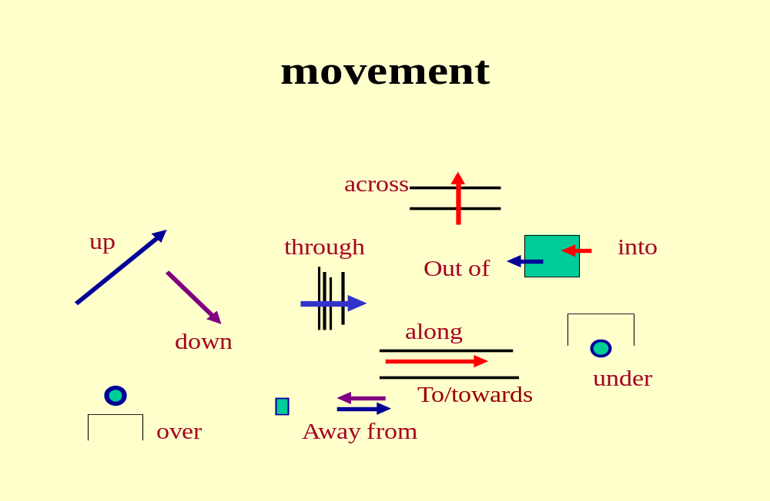
PREPOSITION OF MOVEMENTS

Slide 37
PREPOSITION OF PLACE
ON, ONTO, OVER, ABOVE
BELOW, UNDER, NEATH, BENEATH, UNDERNEATH
IN, INSIDE, INTO
BESIDE, BEFORE, IN FRONT OF, OPPOSITE, BEHIND,

Slide 38
Be careful not to use redundant phrases
For example:
Alternative choices – alternatives
Actual experience - experience
‘Various differences” (Various implies difference so you do not need both words)
The whole entire world (Same as above)
A round circle
Refer back
An eyewitness present at the scene
Avoid starting sentences with linking words
Such as but, and or yet.
for, and, nor, but, or, yet, so

Slide 39
Plural – and spelling mistakes
Rule – 1: adding ‘s’
Plural number – only applicable to Countable Noun
Boy- Boys girl – girls
Horse – horses room – rooms
Tiger – tigers candle – candles
Boat- boats dog – dogs

Slide 40
Rule – 2: ending with x, ch, z, s, sh then add ‘es’
Box – boxes fox – foxes
Brush – brushes bush – bushes
Bus – buses dish – dishes
Class – classes Topaz – topazes
bench – benches Brach – branches
Exception : if ‘ch’ sounds like ‘K’ then only ‘s’
Stomach – stomachs
monarch – monarchs Stomach – Stomachs

Slide 41
Rule : 3 by changing the vowel
Man – men Woman – Women
Tooth – teeth foot – feet
Goose – geese child – children
Exception : NEVER HUMAN – HUMEN (humans)
Some times both vowel and consonant
Mouse – mice
Louse – lice

Slide 42
Rule – 4 : Noun with ‘y’ at ending and consonant before it – then ‘ies’
Duty – duties Fly – Flies
Lady – Ladies Baby – Babies
City – Cities story – stories
Pony – ponies spy – spies

Slide 43
Rule 5 : Noun with y at ending and vowel before it – then only s
Day – days play - plays
Monkey – monkeys toy – toys
Boy – boys key – keys

Slide 44
Rule 6 : word ending with quy, then add only ies without y
Soliloquy – soliloquies
Obloquy – obloquies

Slide 45
Rule 7 : noun ending with o and consonant before it , then add es
Negro – Negroes Mango – Mangoes
Cargo – Cargoes hero – heroes
Volcano – volcanoes echo – echoes
Potato – potatoes Motto – mottoes
Exception :
Solo – solos Piano – Pianos
Memento – Mementos Proviso – Provisos

Slide 46
Rule 8: word ending with oo, o, wo, yo, io and vowels before them, then add s
Studio – studios Radio – radios
Cuckoo – Cuckoos Bamboo – bamboos
Curio – Curios Folio – folios

Slide 47
Rule 9 : word ending with f or fe then add ves omitting f/fe
Wife – wives Calf – calves
Elf – elves Thief – Thieves
Leaf – Leaves Life – Lives
Half – Halves Wolf – Wolves
Shelf – Shelves Knife – Knives

Slide 48
Rule 10: word ending with gh, ph and if they are ‘f’ in pronunciation then add ‘s’
Laugh – laughs
paragraph – paragraphs

Slide 49
Rule 11 : for compound words add s to the base / main word
Father – in – law > Father – in – laws
Step – son > step – sons
Man of war > Men of War
Passer by > Passers by
Step – mother > Step mothers
Space ship – space ships
Commander in chief – commanders in chief
Governor – general – governors general

Slide 50
WRONG OR MISSING INFLECTED ENDS
1. “different from” vs. “different than”
“different from” is considered correct
2. “toward” vs. “towards”
“towards” is correct / Toward is Old Form (Avoid)
Also include commas in a list: “Apples, oranges, pears and bananas…”
Machines, Instrument and screen and hammer (comma for all but last)

Slide 51
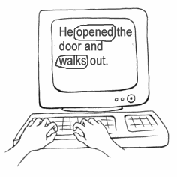
Inconsistency: Tense or Form

Slide 52
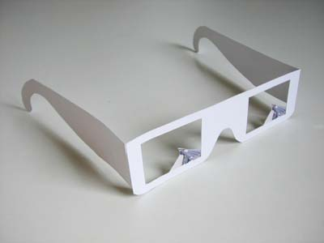
Unnecessary Shift in Person
Don't shift from "I" to "we" or from "one" to "you" unless you have a rationale for doing so.

Slide 53
8. Must Avoid expressions like these…
(never used in academic writing)
kind of sort of type of really basically quite simple very good sample one important thing | definitely actually generally individual specific particularly OK / Okay

Slide 54
THANK YOU

